Slide 1
SMARTCORP
Global Corporate Performance Analysis
Dataset: Forbes Global 2000 Companies 2025 | Source: Kaggle
Presented to: Chinedu Okoli, Chief Business Officer | Aisha Musa, Head of Corporate Strategy
Prepared by: TechCrush Data Analytics Group 20 Team — Smart Corp Capstone Project | June 2026
Kaggle Dataset
Excel
Power BI

Slide 2
AGENDA
01
Project Overview & Business Problem
06
Geographic Analysis
02
About the Dataset
07
Investment Intelligence
03
Data Cleaning Process
08
Key Insights & Strategic Recommendations
04
Company Performance Analysis
09
Conclusion & Next Steps
05
Industry Analysis

Slide 3
PROJECT OVERVIEW
THE BUSINESS PROBLEM
OUR OBJECTIVE
STAKEHOLDERS
SmartCorp manages a diverse global portfolio but lacks clear visibility into performance, underperforming assets, and where to invest next.
Analyze 2,000 global companies across Sales, Profit, Assets & Market Value to deliver data-backed strategic recommendations and Key Insight.
Aisha Musa — Head of Corporate Strategy
Chinedu Okoli — Chief Business Officer
TechCrush Data Analytics Group 20 Team
Core Question: Where should SmartCorp focus its energy and capital over the next 1–3 years?

Slide 4
ABOUT THE DATASET
2,000
8
60+
20+
Global Companies
Original Columns
Countries
Industries
Source: Forbes Global 2000 — 2025 | Platform: Kaggle | Format: CSV
Rank
Company
Country
Industry
Sales ($B)
Profits ($B)
Assets ($B)
Market Value ($B)
+ 9 Calculated Columns Added During Cleaning:
Profit_Margin_%
ROA_%
MV_to_Asset_Ratio
Sales_to_MV_Ratio
Performance_Status
Size_Level
Investment_Score
Valuation_Scale
Country_Region

Slide 5
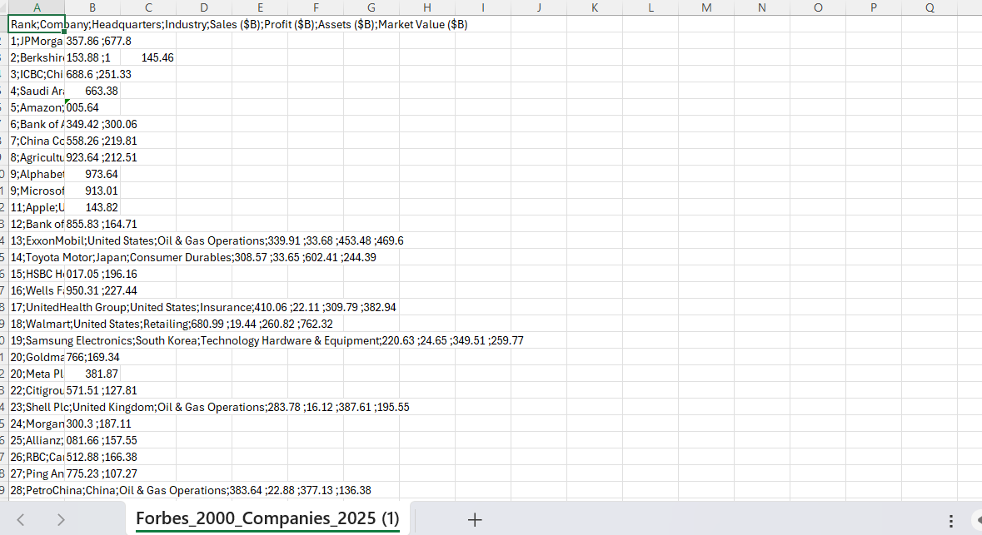
RAW DATASET — Original Data Before Cleaning
2,000 rows + 1 header row | 8 original columns | Source: Kaggle Forbes Global 2000 — 2025

Slide 6
DATA CLEANING PROCESS
01
No duplicates or blank cells found — 2,000 rows intact
05
Rank 334 company name: replaced unreadable decimal value with 'Unknown'
02
Column headers renamed: removed symbols & spaces → Sales_$B, Profit_$B etc.
06
Formatted columns: Company/HQ/Industry → Text; Rank → Number; numerics → 2 dp
03
Deleted Ranks 1488 & 1821: impossible negative and zero sales values
07
Added 9 calculated columns: Profit_Margin_%, ROA_%, MV/Asset, Performance_Status etc.
04
Corrected Ranks 879 & 1321: double decimal errors 0.513.7 → 0.51 and 0.703.6 → 0.70
08
Final dataset: 1,998 rows + 1 header | 17 columns | 127 loss-making companies identified

Slide 7
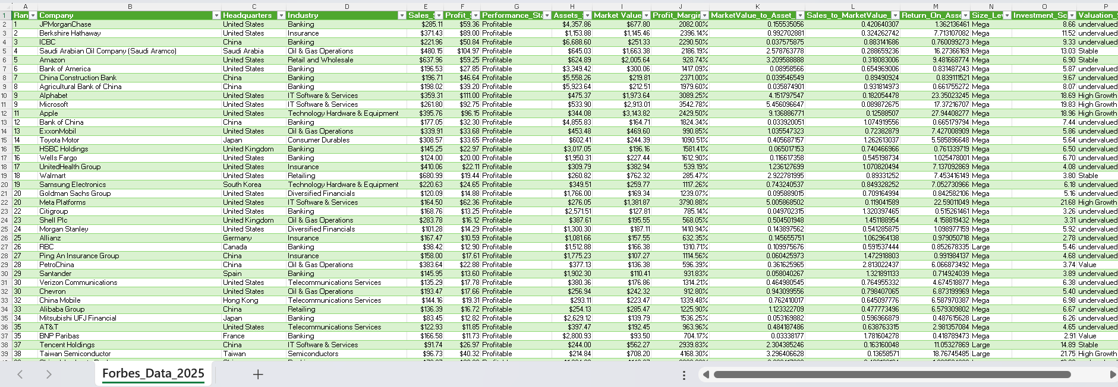
CLEANED DATASET — Ready for Analysis
Total Rows: 1,998
Total Columns: 17
Loss-Making: 127
Profitable: 1,871

Slide 8
ANALYSIS
&
VISUALIZATION
Company Performance | Industry | Geographic | Investment Intelligence

Slide 9
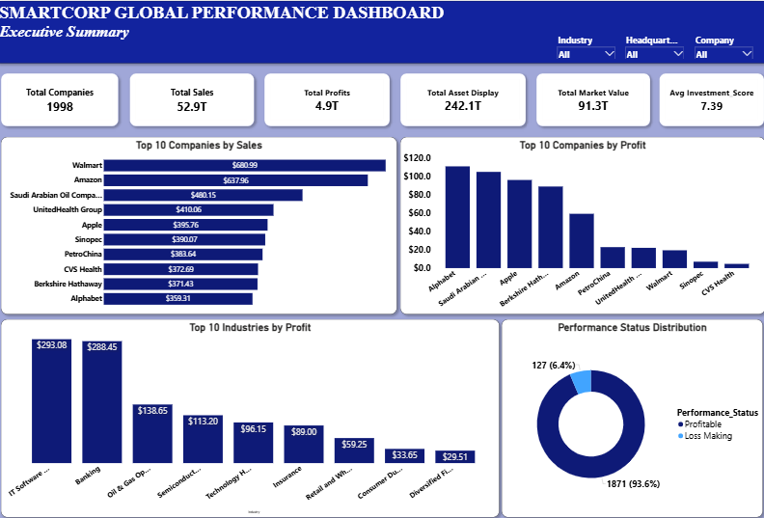
EXECUTIVE SUMMARY DASHBOARD
Dashboard Page 1 of 4
1,998
$52.9T
$4.9T
$242.1T
$91.3T
7.39
Total Companies
Total Sales
Total Profit
Total Assets
Market Value
Avg Investment Score
Walmart leads Sales at $680.99B | Alphabet leads Profit at $111B | 93.6% of companies are profitable

Slide 10
COMPANY PERFORMANCE — Key Findings
1
Walmart Paradox
3
Rank Is Misleading
$680.99B in sales yet only 2.86% profit margin. World's largest retailer keeps less than 3 cents per dollar earned.
Several companies ranked 50–200 outperform top-20 peers on profit margin. Rank alone is a poor performance indicator.
2
Alphabet Leads Profit
4
93.6% Profitable
Alphabet tops profit at $111B — Tech companies dominate profitability despite not always leading in raw sales.
Only 127 of 1,998 companies are loss-making. The global corporate landscape is largely healthy and sustainable.

Slide 11
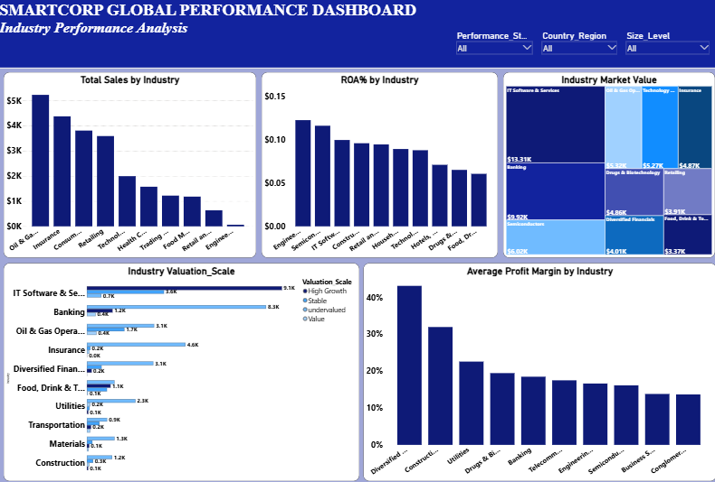
INDUSTRY PERFORMANCE DASHBOARD
Dashboard Page 2 of 4
Highest Sales
Highest Profit Margin
Highest Market Value
Lowest Margin
Oil & Gas
Diversified Financials 43.1%
IT Software & Services
Retailing 13.7%

Slide 12
INDUSTRY ANALYSIS — Key Findings
SALES LEADER
Oil & Gas leads total sales at $5,231.75B — significantly ahead of Insurance ($4,376.69B) and Consumer sector
TOP MARGIN
Diversified Financials has the highest profit margin at 43.1% — the most efficient industry, 3x the global average
MV LEADER
IT Software & Services leads market value at $13.31K — investors place the highest future premium on tech companies
CAUTION
Retailing has the lowest profit margin at 13.7% — confirmed by Walmart's 2.86% — volume business, thin returns
BEST ROA
Engineering leads ROA at 0.12% alongside Semiconductors — these sectors convert assets most efficiently

Slide 13
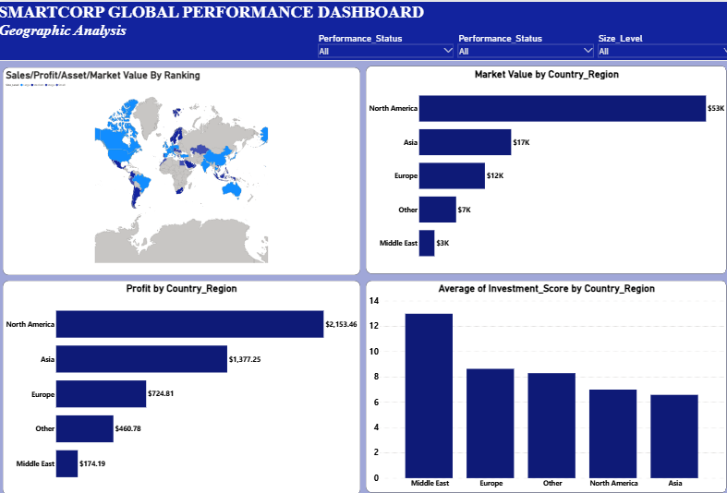
GEOGRAPHIC ANALYSIS DASHBOARD
Dashboard Page 3 of 4
North America MV
Asia Profit
Middle East Inv. Score
Europe Profit
$53K — Dominant
$1,377.25B
12.99 — Highest
$724.81B

Slide 14
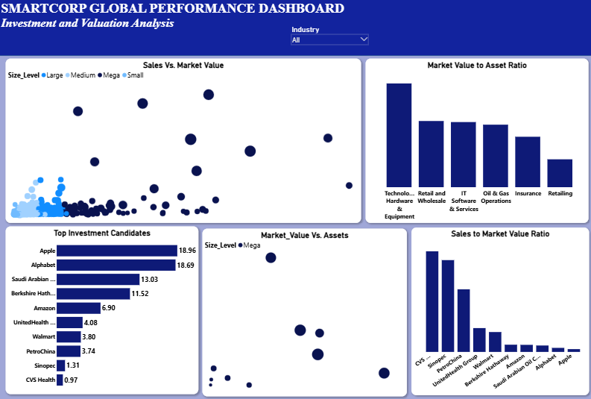
INVESTMENT & VALUATION DASHBOARD
Dashboard Page 4 of 4
Top Score
2nd Score
Tech MV/Asset
Investment Candidates
Apple 18.96
Alphabet 18.69
Highest Ratio
Multiple Identified

Slide 15
KEY INSIGHTS — What the Data Tells Us
Company Performance
Industry Analysis
• Walmart leads sales at $680.99B but retains only 2.86% margin
• Oil & Gas leads total sales at $5,231.75B
• Alphabet leads profit at $111B — tech is the efficiency champion
• Diversified Financials most efficient at 43.1% margin
• Rank does not reliably predict profit performance
• IT Software leads market value — investors bet on tech
Geographic Analysis
Investment Intelligence
• North America dominates MV at $53K
• Apple & Alphabet top investment scores at 18.96 and 18.69
• Middle East has highest investment score at 12.99
• Technology Hardware leads MV to Asset ratio
• Asia ranks lowest on investment quality despite high profit
• Saudi Arabian Oil & Berkshire are strong non-tech alternatives

Slide 16
STRATEGIC RECOMMENDATIONS FOR CHINEDU OKOLI — CBO
✅ INVEST
⚠ MONITOR
❌ CAUTION
IT Software & Services
+ Middle East Region
Oil & Gas &
Diversified Financials
Retailing Sector
+ Asia Region
Highest investment scores (Apple 18.96, Alphabet 18.69), top market value, and strongest MV/Asset ratio. Middle East leads investment quality at 12.99 score — underexplored high-return region.
Oil & Gas leads sales but margins are moderate. Diversified Financials has exceptional 43.1% margin but limited scale. Both warrant deeper due diligence before major capital deployment.
Retailing has the lowest margin (13.7%) and the highest Sales/MV ratio — the market undervalues retail revenue. Asia ranks lowest on investment quality (6.58) despite high profit volume.

Slide 17
IMPLEMENTATION ROADMAP
SHORT TERM
MEDIUM TERM
LONG TERM
0 – 3 Months
3 – 12 Months
1 – 3 Years
→ Deep due diligence on Apple, Alphabet & Saudi Aramco as investment candidates
→ Initiate strategic partnership discussions with top-scored companies
→ Build portfolio concentration in high-margin, asset-efficient sectors
→ Begin reducing exposure to loss-making companies in Retailing sector
→ Explore Middle East market entry opportunities
→ Establish continuous performance monitoring framework using this analysis
→ Benchmark internal portfolio companies against Forbes 2000 peers
→ Monitor Oil & Gas and Diversified Financials margin trends
→ Reduce Asia exposure unless investment quality scores improve

Slide 18
5 THINGS SMARTCORP NEEDS TO KNOW
01
Rank alone does not reflect true corporate performance — profit margin is the real indicator
02
Oil & Gas leads sales but Diversified Financials leads profitability — size ≠ efficiency
03
North America and Asia dominate in volume — but geographic diversification is a strategic priority
04
Retailing shows signs of significant market undervaluation despite enormous revenue generation
05
Apple, Alphabet, Saudi Aramco & Berkshire Hathaway are the strongest investment candidates in the dataset

Slide 19
CONCLUSION
This analysis of 1,998 global companies across sales, profitability, assets, and market value reveals that SmartCorp's greatest strategic opportunity lies in the Technology sector and the Middle East region, where high investment scores, strong margins, and growing market confidence converge to offer the most compelling risk-adjusted returns in the global corporate landscape.
By prioritizing investment in high-margin, asset-efficient companies while reducing exposure to structurally underperforming sectors, SmartCorp can achieve sustainable portfolio growth over the next 1 to 3 years.
"The data is clear. The opportunity is now. The decision is yours."

Slide 20
THANK YOU
We welcome your questions and discussions
Prepared by: TechCrush Data Analytics Group 20 Team
Program: TechCrush Data Analytics Capstone Project — Cohort 6
Dataset: Forbes Global 2000 Companies 2025 | Source: Kaggle
Tools Used: Microsoft Excel | Power BI Desktop
SmartCorp Global Performance Analysis — 2025

